Slide 1




14 - 16 NOVEMBER 2023
RIYADH, SAUDI ARABIA
Introduction to the Catsniffer
Paulino Calderon (@calderpwn)
paulino@pwnlab.mx
https://github.com/ElectronicCats/CatSniffer
ORGANISED BY:
IN ASSOCIATION WITH:

Slide 2
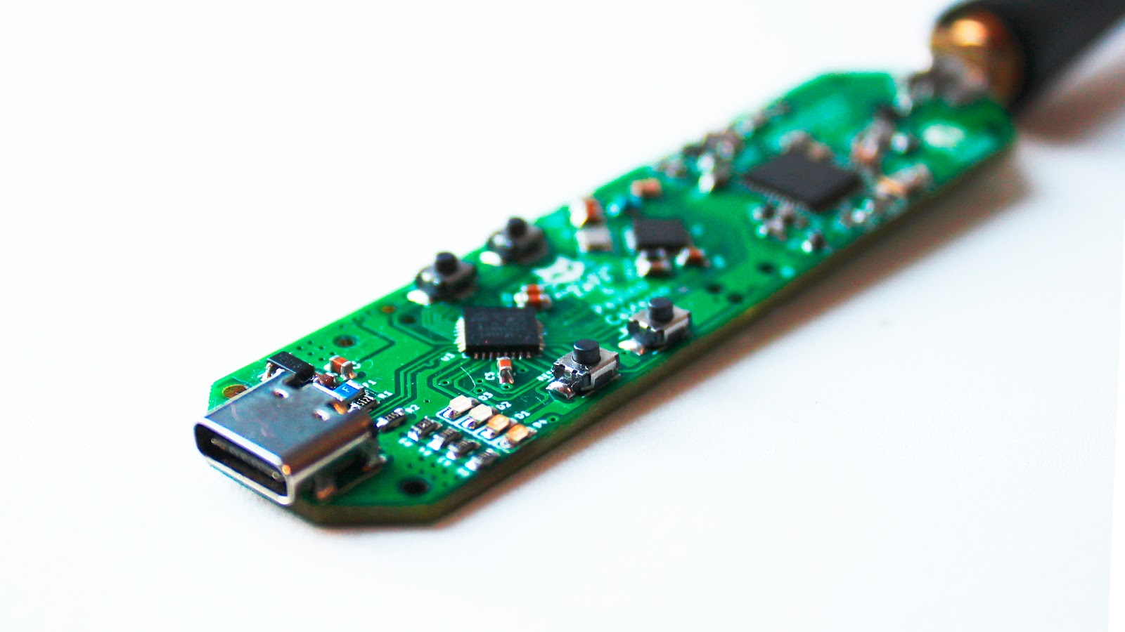
What is the catsniffer?
CatSniffer (😼) is an innovative, multi-protocol, multi-band open source circuit board made for sniffing, communicating, and attacking IoT (Internet of Things) devices. It was designed as a highly portable USB stick that integrates TI CC1352, Semtech SX1262, and Microchip SAMD21E17 (V1.x and V2.x)/RP2040 (V3.x).

Slide 3

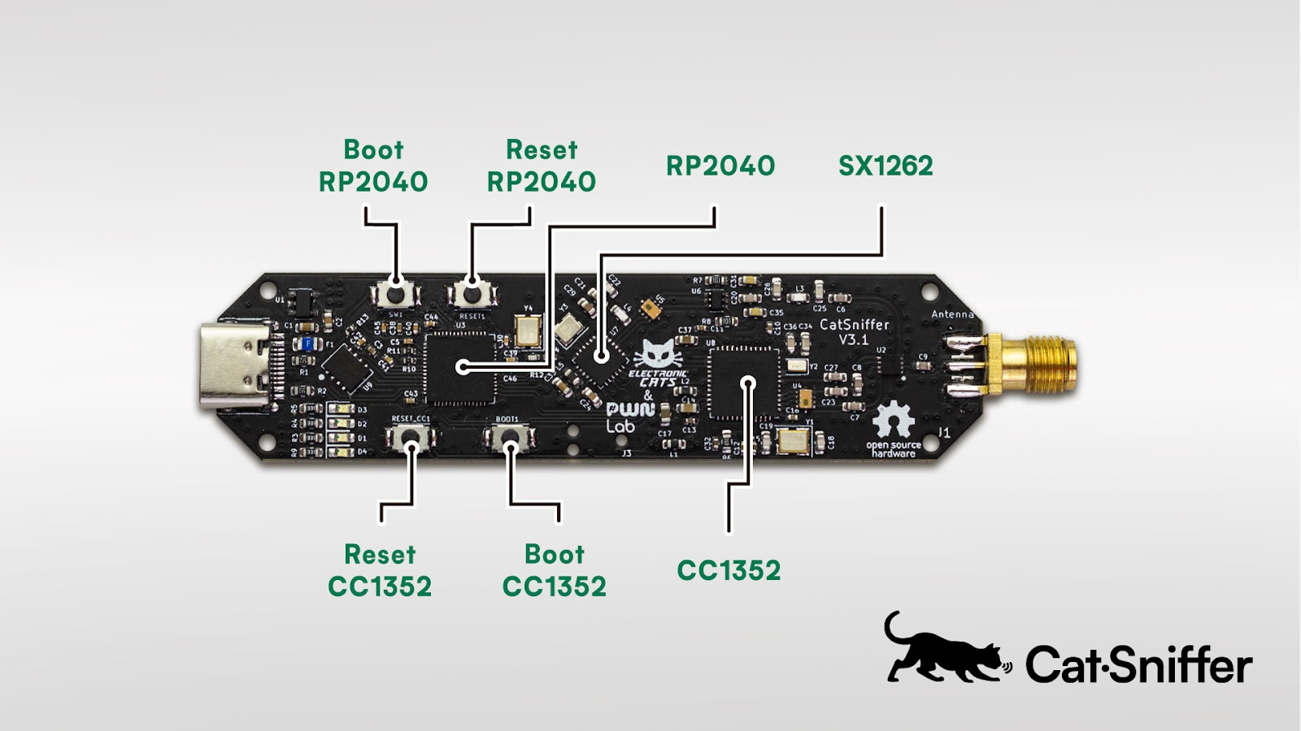

Slide 4
Supported Software
This board is a Swiss army knife for IoT security researchers, developers, and enthusiasts. It's highly versatile, compatible with a wide array of software, including:
Custom firmware developed by PWNLAB/ElectronicCats
Packet Sniffers (*)
Security Auditing tools

Slide 5
Protocols
1.x/2.x
3.x
Thread
Zigbee
Bluetooth 5 Low Energy (BLE)
IEEE 802.15.4g
6LoWPAN (IPv6 over Low power Wireless Personal Area Networks)
Sub 1Ghz and patented systems
LoRa/LoRaWAN
Antenna support: 868/915 MHz up to 14 dBm, 2.4 GHz up to 20 dBm
RP2040 microcontroller
+Wi-SUN
+Amazon Sidewalk
+mioty®
Antena support: 433 MHz up to 13 dBm, 2.4 GHz up to 10 dBm

Slide 6
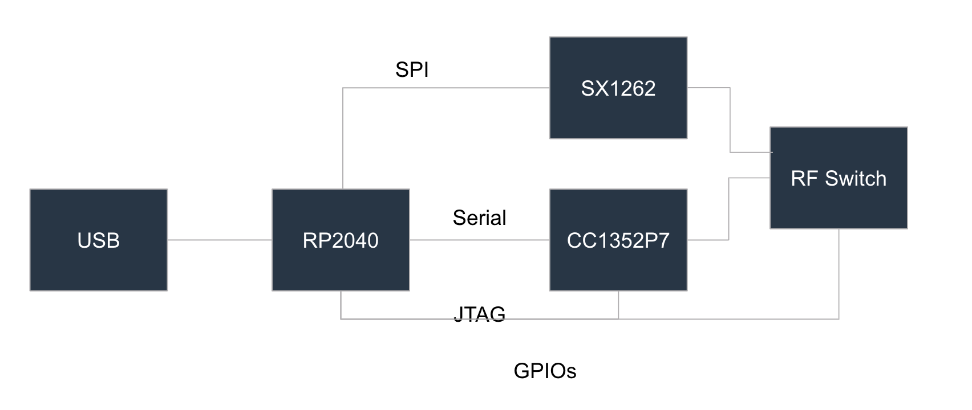

Slide 7
Practical Examples
Uploading and testing firmwares
Notes:
screen /dev/ttyACM0 921600

Slide 8
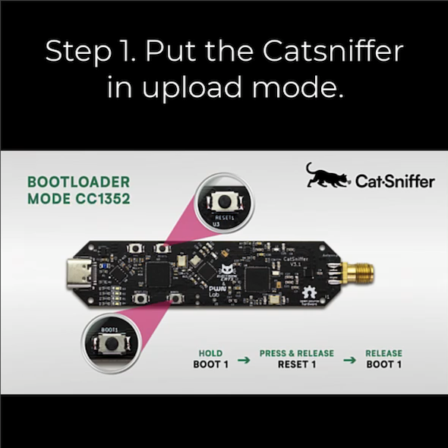

Slide 9


Slide 10
14 - 16 NOVEMBER 2023
RIYADH, SAUDI ARABIA
Thank you!
Paulino Calderon (@calderpwn)
paulino@pwnlab.mx
https://github.com/ElectronicCats/CatSniffer
ORGANISED BY:
IN ASSOCIATION WITH:

